Slide 1
SqlDataReader Class in ADO.Net
Presenter: RAGHU PRASAD K S

Slide 2
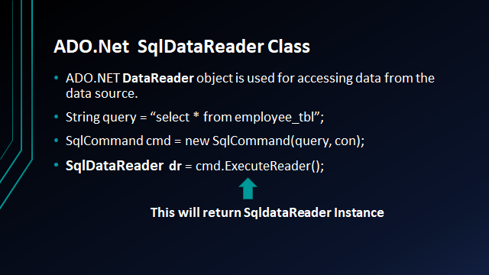

Slide 3
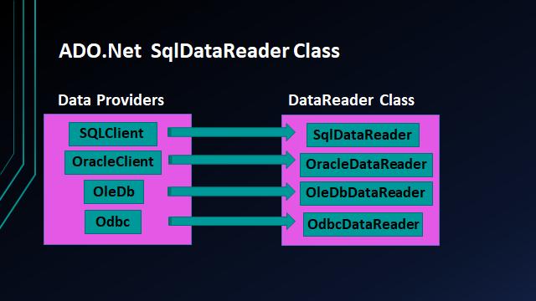
ADO.Net SqlDataReader Class With Different Data Providers

Slide 4
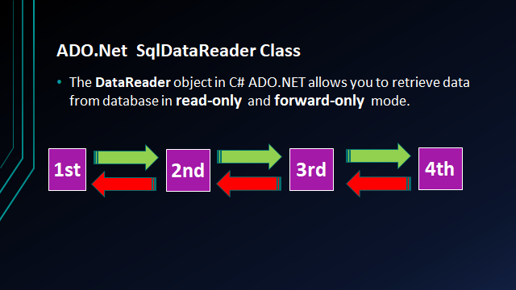

Slide 5
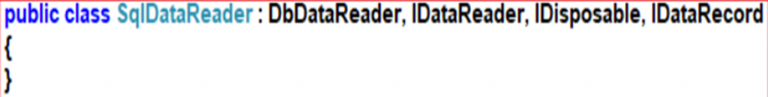
Signature SqlDataReader

Slide 6
ADO.Net SqlDataReader Class
It means you can only read and display data but can’t update or delete data.
If you want to make modification in retrieved data you need to use DataAdapter instead of DataReader.
SqlDataReader Object provides a connection oriented data access to the SQL Server data Sources from C# applications.
ExecuteReader() in the SqlCommand Object sends the SQL statements to the SqlConnection Object and populate a SqlDataReader Object based on the SQL statement or Stored Procedures.

Slide 7
ADO.Net SqlDataReader Class
Object of SqlDataReader cannot be created using new keyword.
SqlDataReader dr = new SqlDataReader();
ExecuteReader() method of SqlCommand create and returns an object of SqlDataReader.
SqlDataReader is read-only. It means it is also not possible to change the data using SqlDataReader.
You also need to open and close the connection explicitly.

Slide 8
WHY AND WHEN TO USE DATAREADER?
When you want to only display information or search result, you can use DataReader. There are various advantages of using DataReader like:
1. The retrieved data is stored in the network buffer in the client and then the client can read data using Read method. As data gets stored in the client network buffer it increases application performance significantly.
2. By default DataReader stores only one row at a time in memory. It reduces system overhead.

Slide 9
Properties Of SqlDataReader Class
FieldCount (int): It gets the number of columns in the current row.
HasRows (boolean): It gets a value that indicates whether the System.Data.SqlClient.SqlDataReader contains one or more rows.
IsClosed: It retrieves a Boolean value that indicates whether the specified System.Data.SqlClient.SqlDataReader instance has been closed
Item[String]: It gets the value of the specified column in its native format given the column name.
Item[Int32]: It gets the value of the specified column in its native format given the column ordinal.

Slide 10
Methods Of SqlDataReader Class
Read(): It Advances the System.Data.SqlClient.SqlDataReader to the next record and returns true if there are more rows; otherwise false You can read data by using concatenation and placeholder syntax in console application.
GetName(int i): It gets the name of the specified column. Here, parameter i is the zero-based column ordinal.
NextResult(): It advances the data reader to the next result when reading the results of batch Transact-SQL statements.

